Slide 1
Centralized Blockchain
NOT GDPR!!!
Sia Ghassemi | appvelopment

Slide 2






Thank you, sponsors!

Slide 3
Centralized Blockchain
EventSourcing

Slide 4
Agenda
What is Blockchain?
How does Blockchain work (a, b, c)
What is that?
What customers want

Slide 5
What’s blockchain?
4 characteristics that set blockchain apart
distributed
smart contracts
consensus
immutability
Source: https://www.ibm.com/blogs/cloud-computing/2017/04/11/characteristics-blockchain/

Slide 6
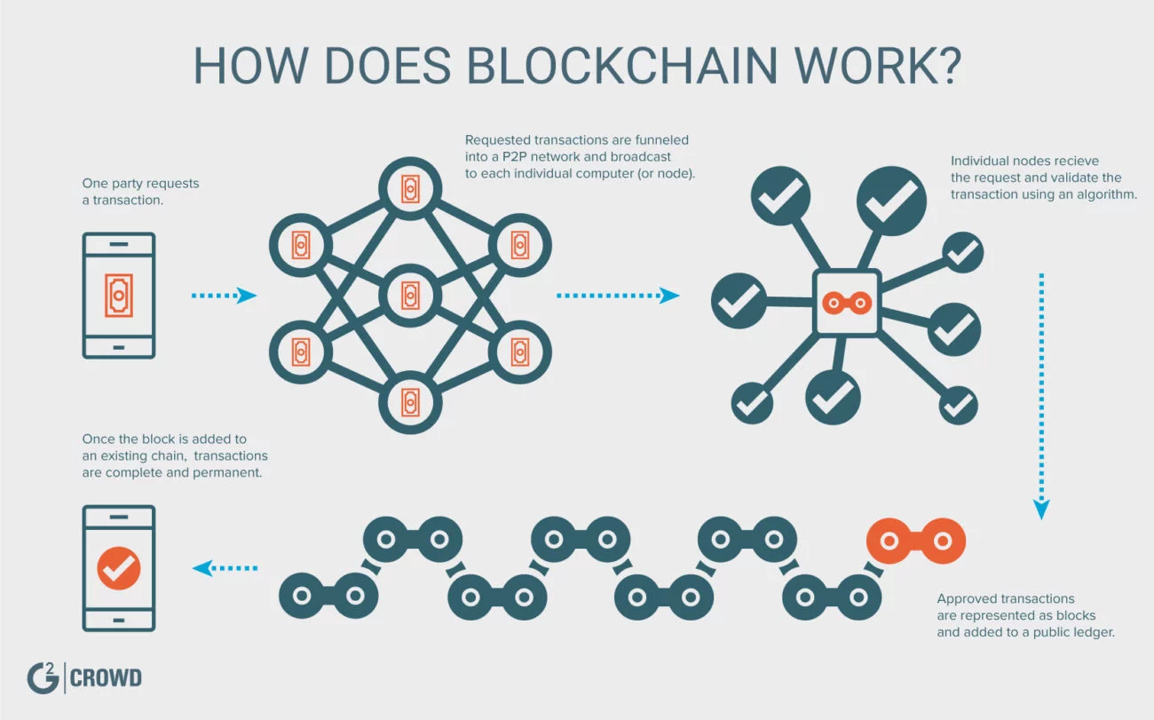

Slide 7
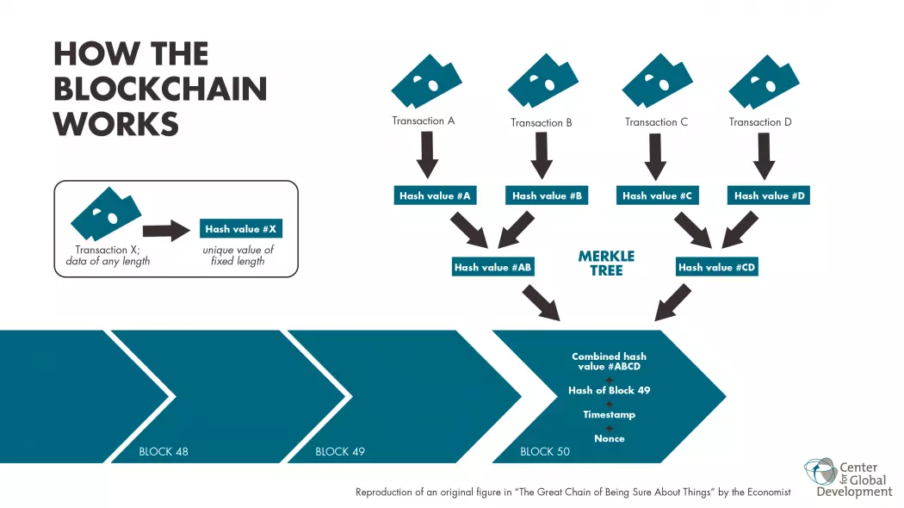

Slide 8
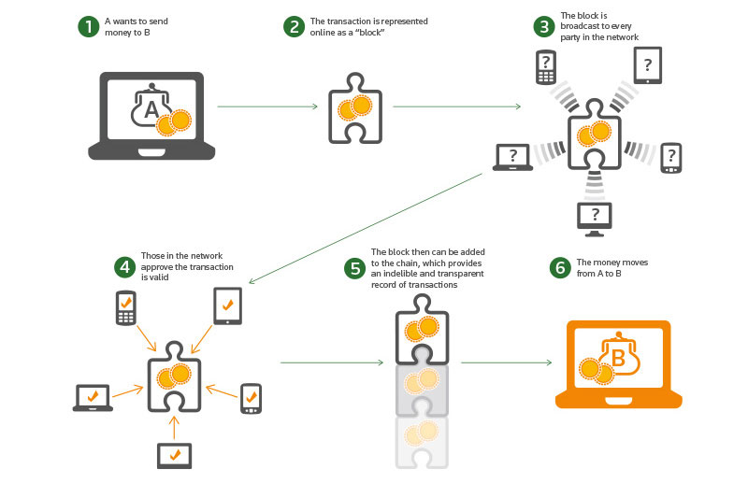

Slide 9
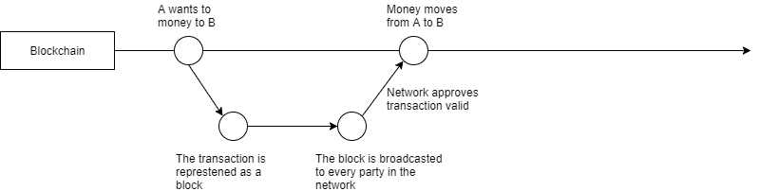

Slide 10
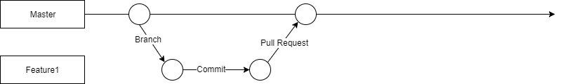

Slide 11
Customer
Want Blockchain!
What for?
Immutability!
Distributed?
No!
Centralized?
Yes!
Here is what you need!

Slide 12
Centralized blockchain
4 characteristics that set blockchain apart
distributed
smart contracts
consensus
immutability
Source: https://www.ibm.com/blogs/cloud-computing/2017/04/11/characteristics-blockchain/

Slide 13
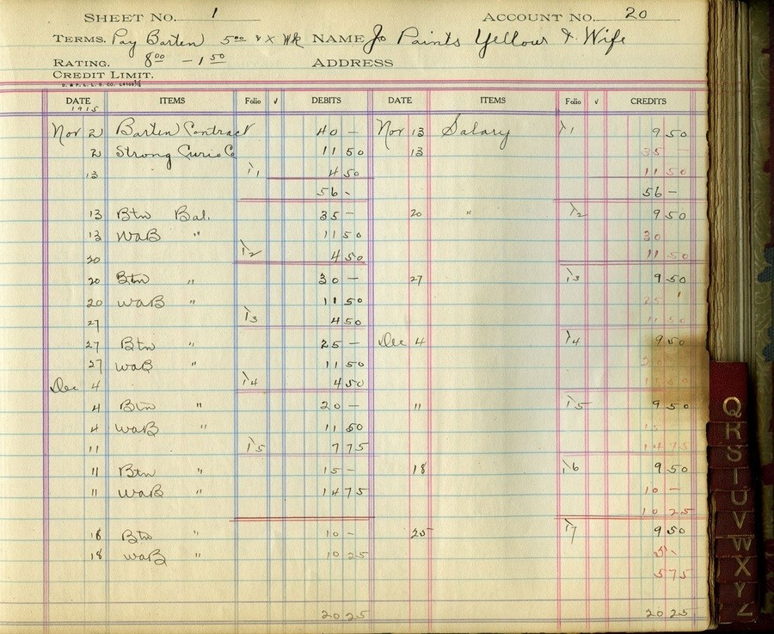
Append Only Ledger

Slide 14
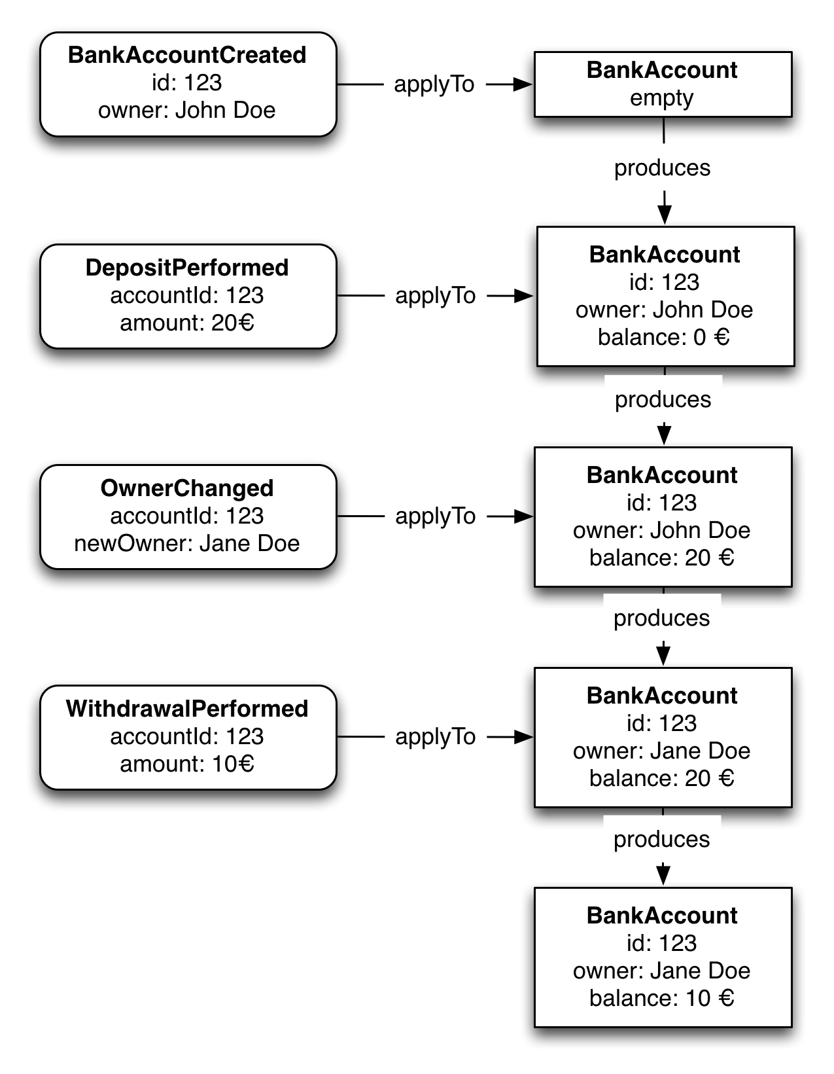
Event Sourcing

Slide 15
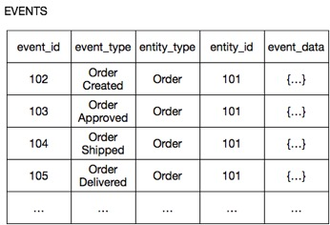
Event Sourcing

Slide 16
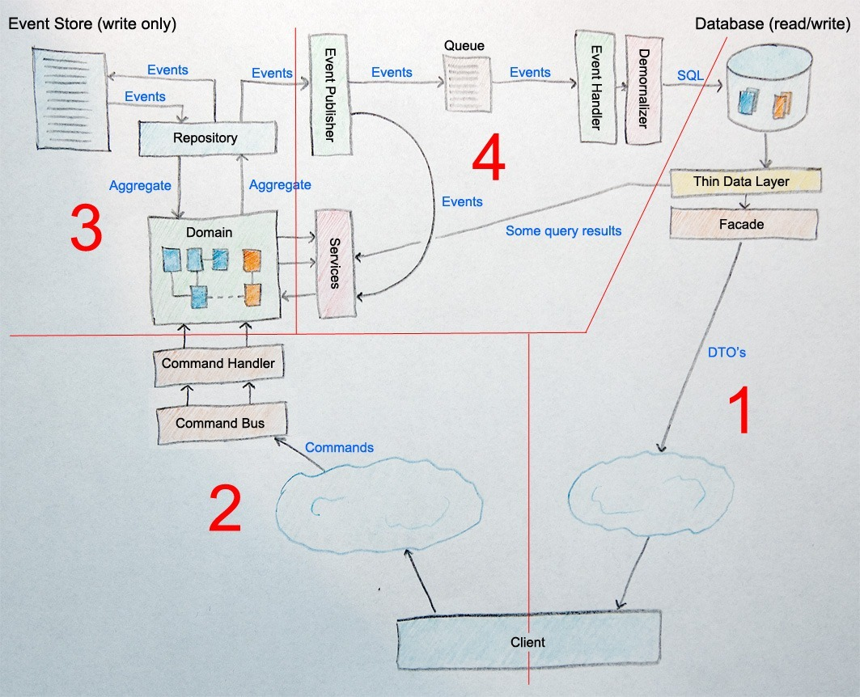
CQRS & Event Sourcing

Slide 17
BUT I WANT CLOUD!

Slide 18
Serverless CQRS

Slide 19
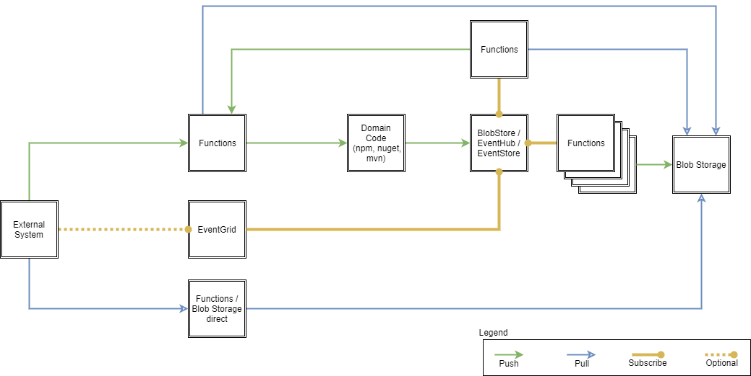
Serverless CQRS

Slide 20
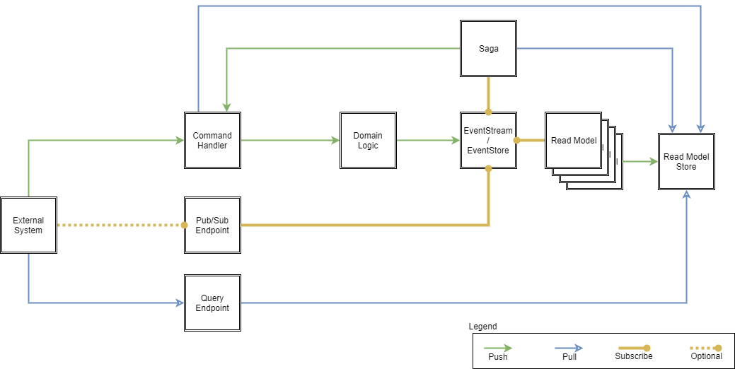
Serverless CQRS

Slide 21
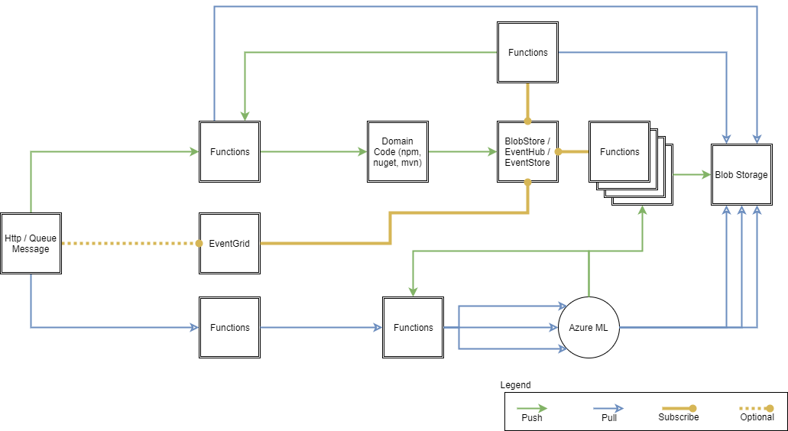
Serverless CQRS - Future

Slide 22
Thank you!

Slide 23
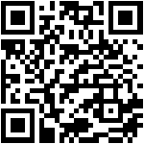
https://form.responster.com/o9RjAi

